Slide 1
FILTER PROPERTY AND CURSOR STYLING
BY:
Jefferson C. Arguelles
Kim Illy Teodoro

Slide 2
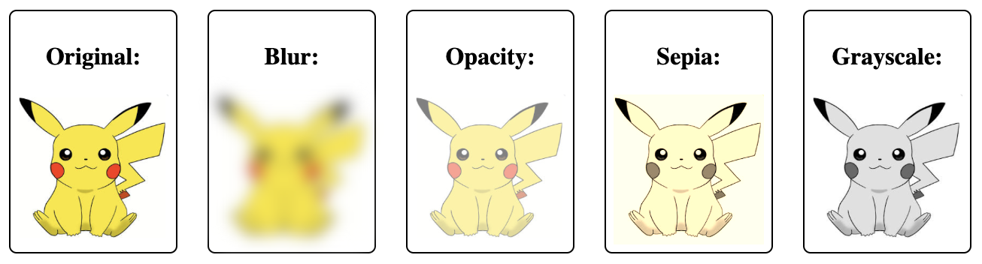
INTRODUCTION TO FILTER PROPERTY
The Filter property in CSS allows for the application of visual effects directly to elements, such as images or text, similar to photo-editing software. It includes various effects like blurring, color adjustments, shadowing, and more, providing designers with tools to enhance or stylize web content dynamically.

Slide 3
Common Filter Effects:
Blur: blur(px) blurs the image by a specified pixel value.
Brightness: brightness(x) adjusts brightness (values above 1 brighten, below 1 darken).
Contrast: contrast(x) increases or decreases contrast.
Drop Shadow: drop-shadow(h, v, blur, color) adds a shadow with customizable horizontal/vertical offsets, blur radius, and color.
Grayscale: grayscale(x) converts the image to grayscale, with 1.0 being fully grayscale.
Hue Rotate: hue-rotate(deg) rotates colors by a given degree around the color wheel.
Invert: invert(x) inverts colors up to full inversion at 1.0.
Opacity: opacity(x) sets the transparency, with 0 being fully transparent.
Saturate: saturate(x) adjusts color saturation (values above 1 increase saturation).
Sepia: sepia(x) applies a sepia filter, simulating an old-fashioned photo effect.

Slide 4
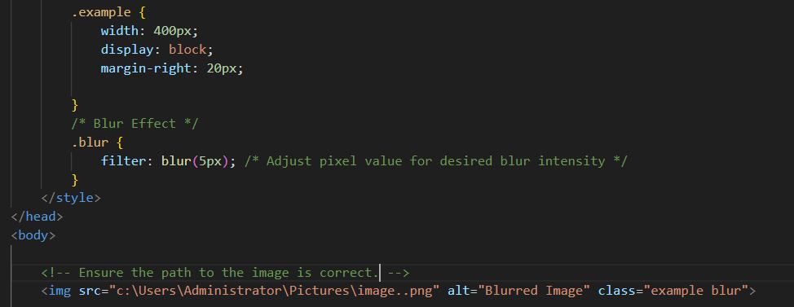

BLUR:
The blur() filter applies a Gaussian blur to the element, creating a softening effect. The parameter is a length value (in pixels) that specifies the radius of the blur
EXAMPLE:

Slide 5
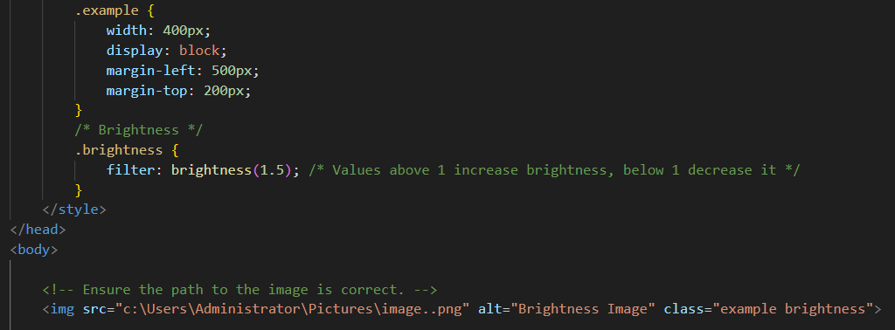

Brightness:
The brightness() filter adjusts the brightness of the element. A value greater than 1 increases brightness, while a value less than 1 decreases it. For example, brightness(1.5) makes the element 50% brighter, and brightness(0.5) reduces brightness by 50%.
EXAMPLE:

Slide 6





Slide 7
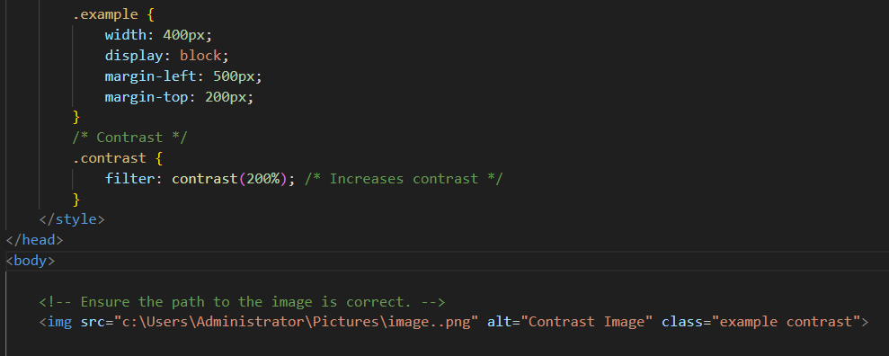


Contrast:
The brightness() filter adjusts the brightness of the element. A value greater than 1 increases brightness, while a value less than 1 decreases it. For example, brightness(1.5) makes the element 50% brighter, and brightness(0.5) reduces brightness by 50%.
EXAMPLE:

Slide 8

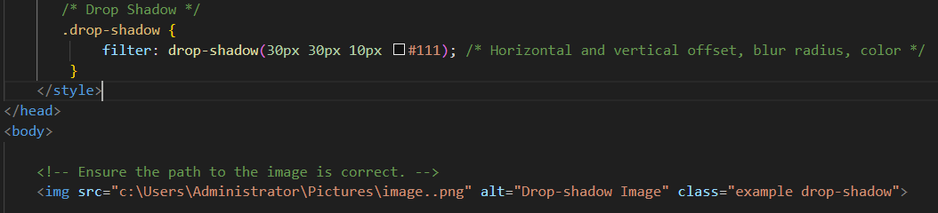
Drop Shadow:
The drop-shadow() filter creates a shadow behind the element. It takes four parameters: the horizontal offset, the vertical offset, the blur radius, and the color of the shadow. For example, drop-shadow(30px 30px 10px #111)) creates a soft black shadow.
EXAMPLE:

Slide 9
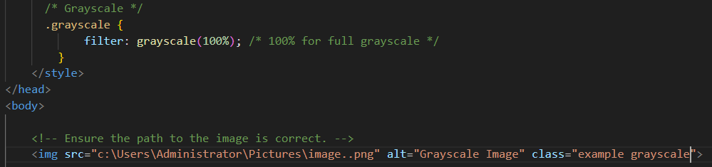



Grayscale:
The grayscale() filter converts the element to grayscale. The parameter can be a percentage from 0% to 100%, where grayscale(0%) is the original image, and grayscale(100%) is fully gray. Intermediate values produce varying shades of gray.
EXAMPLE:

Slide 10

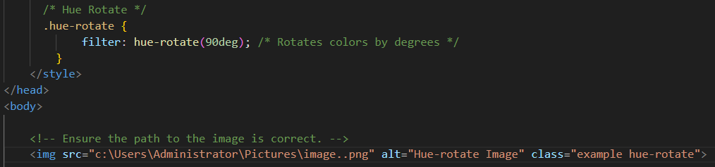
Hue Rotate:
The hue-rotate() filter changes the hue of the element by rotating the colors around the color wheel. The parameter is a degree value (0 to 360 degrees). For example, hue-rotate(90deg) shifts all colors by 90 degrees, altering their appearance.
EXAMPLE:

Slide 11
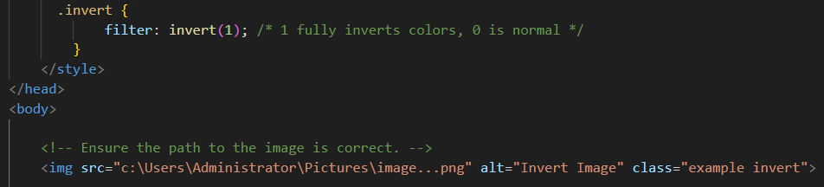


Invert Colors:
The invert() filter inverts the colors of the element. A value of 1 completely inverts the colors (turning black to white, yellow to blue, etc.), while a value of 0 displays the original colors. For instance, invert(0.5) inverts colors by 50%.
EXAMPLE:

Slide 12
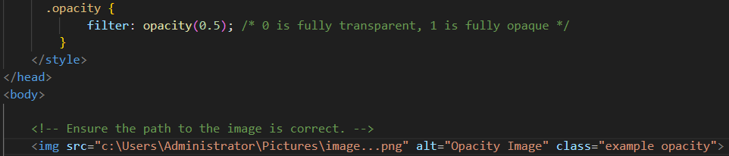

Opacity:
The opacity() filter adjusts the transparency of the element. The parameter ranges from 0 to 1, where opacity(0) is fully transparent, and opacity(1) is fully opaque. For example, opacity(0.5) makes the element 50% transparent.
EXAMPLE:

Slide 13
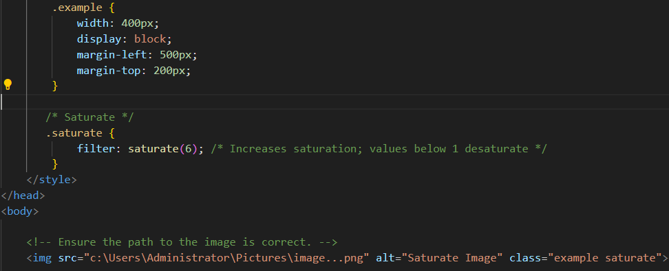
Saturate:
The saturate() filter change the saturation of the element. Values greater than 1 increase saturation (making colors more vibrant), while values less than 1 decrease saturation (making colors more muted). For example, saturate(2) doubles the saturation.
EXAMPLE:

Slide 14


If you have good eye, you will spot the difference
original
saturate

Slide 15

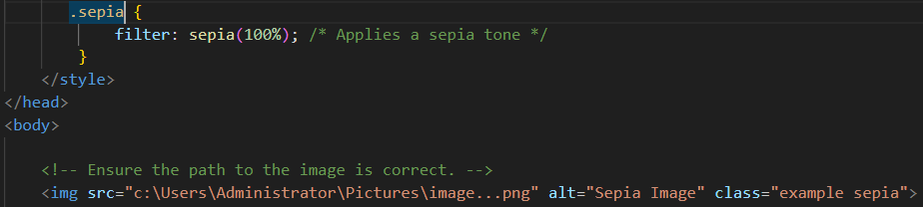
Sepia :
The sepia() filter applies a sepia tone to the element, giving it a warm, brownish tint reminiscent of old photographs. The parameter can be a percentage from 0% to 100%, where sepia(0%) is the original image, and sepia(100%) is fully sepia-toned.
EXAMPLE:

Slide 16

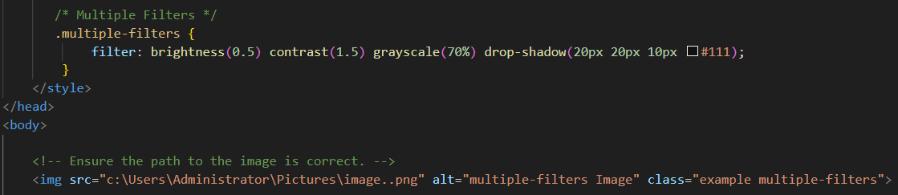
Combining Filters:
Multiple filter effects can be applied simultaneously by separating each effect with a space.
EXAMPLE:

